Slide 1
Dark Pattern User Study
Using the Talk Aloud protocol

Slide 2
Introduction
Dark patterns, or deceptive design patterns, are user interfaces with deliberate design decisions incorporated to include outcomes favorable to the designer at the expense of the user.

Slide 3
Talk-Aloud Protocol
In this study, you will see a series of images from user interfaces.
As you engage with the image, imagine that you are a user using a webpage. Speak aloud every action that you do as you do it, and explain why you are doing it.
Please describe any dark patterns that you think are present, their features, and your perception of how they are deceptive.
You may withdraw your consent from this study at any time.

Slide 4

Image 1

Slide 5
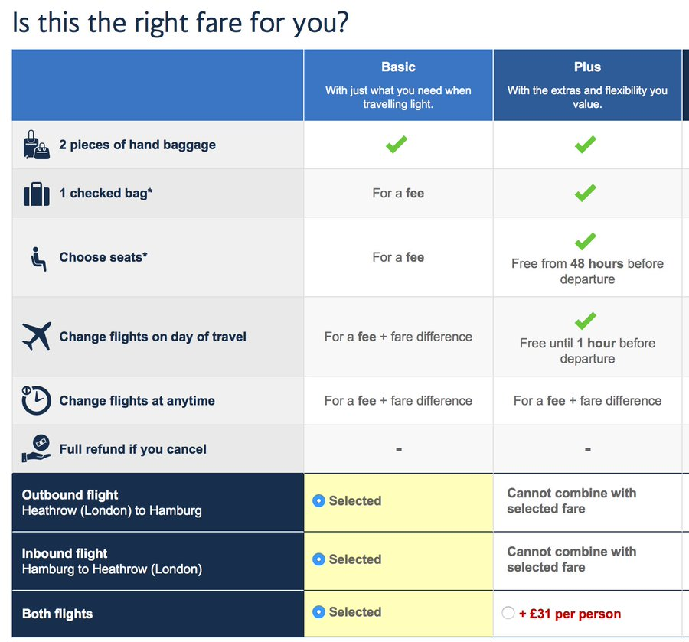
Image 2

Slide 6
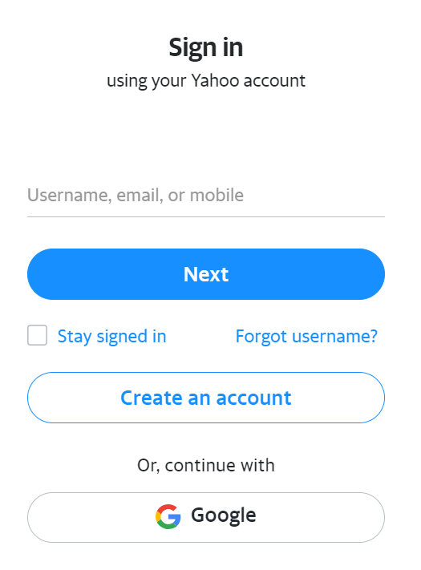
Image 3

Slide 7

Image 4

Slide 8
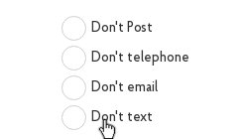
Image 5

Slide 9
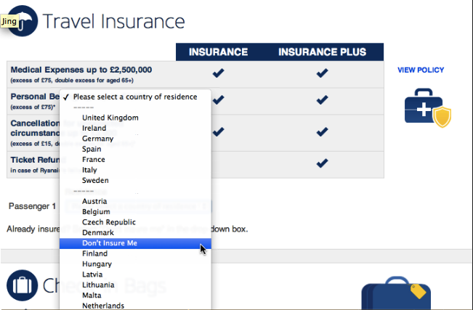
Image 6

Slide 10
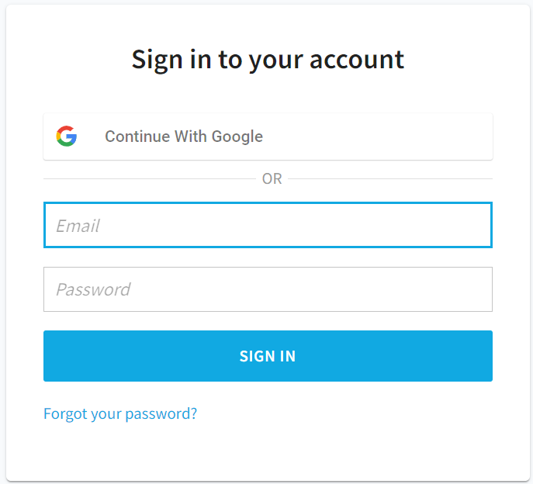
Image 7

Slide 11
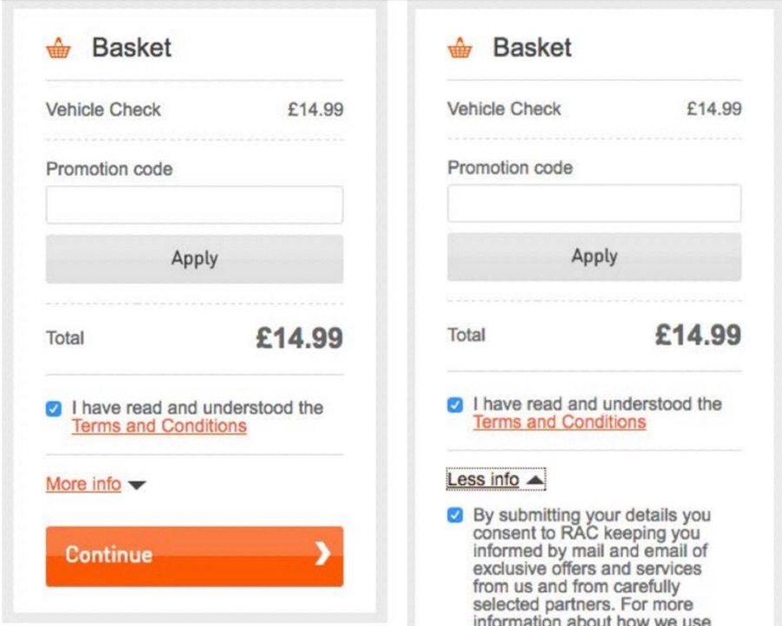
Image 8

Slide 12
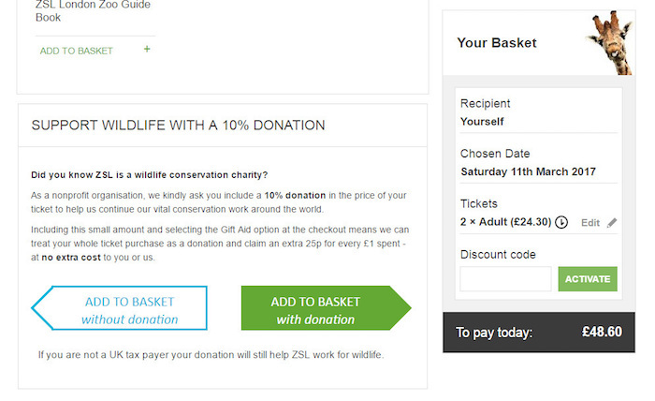
Image 9

Slide 13
Thank you
You have finished the study. You may close the zoom session.

